Slide 1


Slide 2
Randy Ngo
President

Slide 3
https://tinyurl.com/sodabootcampmaterials2021

Slide 4


We are...
https://tinyurl.com/sodabootcampmaterials2021
..the premiere software development club for university students.

Slide 5
What do we do?
https://tinyurl.com/sodabootcampmaterials2021
Industry events
Resume Reviews
Mock Interviews
SoDA Code Challenge
Technical Presentations
Socials
FREE PIZZA! 🍕🍕🍕
Community outreach

Slide 6



Housekeeping
https://tinyurl.com/sodabootcampmaterials2021
/SoDAASU
@asu_soda
@asu_soda
/groups/asusoda

Slide 7
Today
https://tinyurl.com/sodabootcampmaterials2021
Learn Developer Tools
Learn HTML
Learn CSS
Learn JavaScript

Slide 8

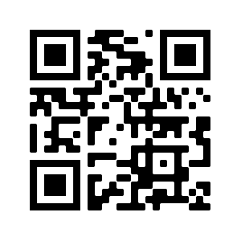
Housekeeping
tinyurl.com/sodanews
discord.gg/EsVNGqSd3Y

Slide 9
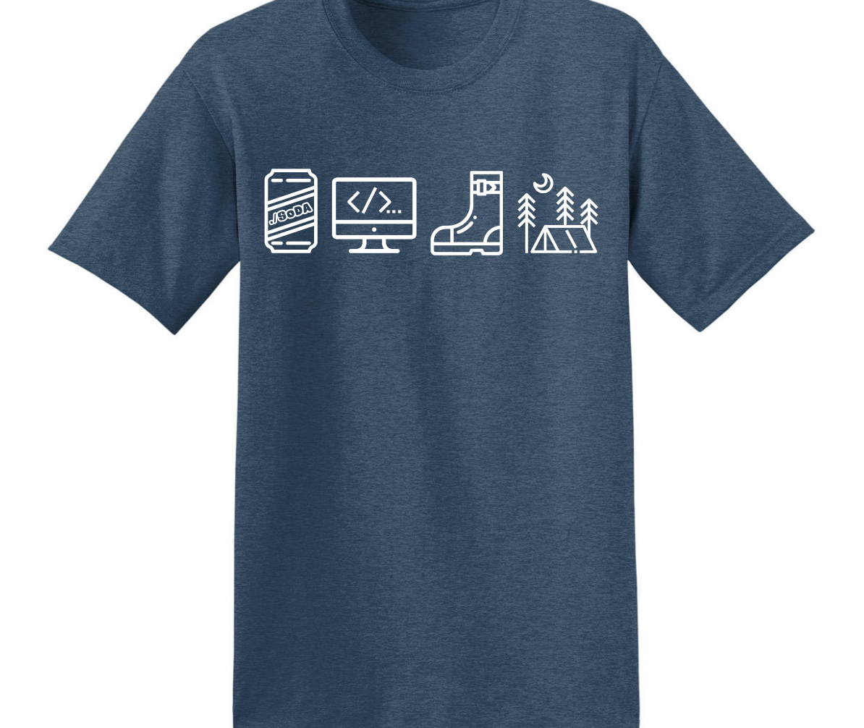
Housekeeping

Slide 10
Developer Tools
(and environment setup)

Slide 11
Developer Tools
First.. What happens if you get stuck?
Google for errors
Stackoverflow is your best friend
Finding and navigating documentation
Every language has documentation and it can be really useful if you’re trying to figure out how to do something

Slide 12

Visual Studio Code
Notes:
Alli: go to downloads, Install vscode. Install tslint

Slide 13
Editors
Your editor is your main instrument to craft a program
– Chefs use the best knife
– Mechanics use the best wrenches
– Bakers use the best ovens
– And they know the ins and outs of their tool
Invest time in learning your editor, whatever it is. Everyone has a different “optimal” setup and that’s okay!

Slide 14

Node.js
Notes:
If they have Windows Subsystem for Linux or Git Bash already, this step is unnecessary

Slide 15

Git Bash (for Windows)

Slide 16
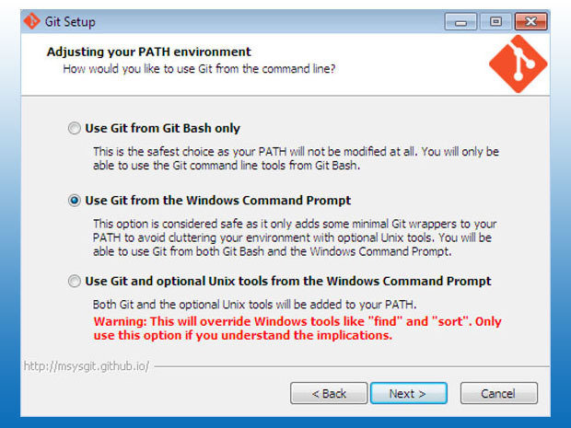
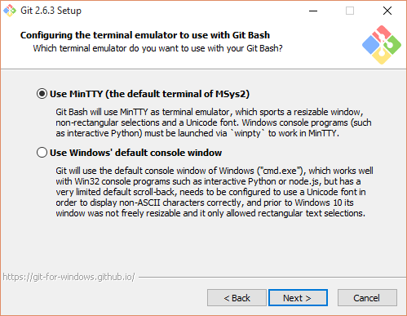
Git Bash (Windows only)

Slide 17
Git Bash (Windows Only)

Slide 18
Terminal
UNIX commands can be very simple one word commands, or they can take a number of additional arguments (parameters) as part of the command.
UNIX command has the following form:
command options(s) filename(s)
Notes:
Alli: The command is the name of the utility or program that we are going to execute.
The options modify the way the command works. It is typical for these options to have be a hyphen followed by a single character, such as -a. It is also a common convention under Linux to have options that are in the form of 2 hyphens followed by a word or hyphenated words, such as --color or --pretty-print.
The filename is the last argument for a lot of UNIX commands. It is simply the file or files that you want the command to work on. Not all commands work on files, such as ssh, which takes the name of a host as its argument.

Slide 19
Terminal
ls : lists the contents of a directory
cd : changes directories
mkdir : creates a directory
rm -rf : removes a directory and all of its contents

Slide 20

Github

Slide 21
Github
Go to github.com
Sign up
Pick a username you can put on your resume
Use your .edu Email
Create a repository titled “SoDA Bootcamp” or something similar
Notes:
Alli:

Slide 22
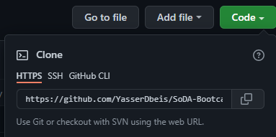
Github
Go to your command line
Type in git config --global user.name “username”
Type in git config --global user.email “email@asu.edu”
Use cd to navigate to where you want to put your project
Copy this:
Notes:
Alli:

Slide 23
Github
Type in git clone pasted link
Change directories into the new folder
Type in npm init
Type in npm install live-server
Type in mkdir assets
Paste the assets you downloaded into that folder
Notes:
Alli:

Slide 24
Notes:
Lewis: GoodMorning, First thing first, Head to this google link, and lets get you downloading the necessary packages.

